Slide 1



DYNAMIC SHINY DASHBOARD
May 5, 2025
Instructor
Dr. Anna Leach
Team Data Decoders
Usha Goud Gourigari
Ankitha Namala
Sree Paada Reddy Pallikila
Abhiram Varma Nandimandalam
Data Decoders

Slide 2

CONTENTS
May 5, 2025
Overview
Problem & Curiosity Explored
Dataset Summary
How did we Explore it?
Dashboard Capabilities
Preprocessing Features
Question 1: Medal Trends and Composition
Question 2: High Endurance Sports Domination and Participation
Paralympic Dashboard Interface
Advantages
Challenges
Conclusion
Data Decoders

Slide 3

OVERVIEW
May 5, 2025
The objective of this project is to develop an interactive dashboard using R Shiny to display Paralympic Games data.
Dataset: Comprehensive history of Paralympic Games.
Technology: R, Shiny, ggplot2, dplyr, tidyr.
Main Goal: Enable interactive, real-time exploratory data analysis.
Overview of Presentation Includes an Exploration of the Data Set and Visuals and Dashboard Abilities and Conclusion Findings.
Data Decoders

Slide 4

PROBLEM & CURIOSITY EXPLORED
May 5, 2025
Can we build a flexible, reusable dashboarding tool that enables students to visualize different aspects of a dataset without hardcoding everything?
Data Decoders

Slide 5

DATASET SUMMARY
May 5, 2025
Dataset Used: Paralympic Dataset (DataDNA Challenge - September 2024).
The information about National Paralympic Committees appears under "npc_new" (country codes).
games_year and games_season: Track event years and seasons.
Each record contains information about three types of medals which comprise of Gold, Silver and Bronze records..
The name of field competitors remains missing from this record.
Data Decoders

Slide 6

HOW DID WE EXPLORE IT?
May 5, 2025
Developed R script that accepts user-supplied raw data, data transformation code, visualization codes and filter fields.
Internally, we checked for missing/ null data, outlier information and duplicate records.
We constructed 2-tab Shiny dashboard embedding the supplied code for data and plots and filter widgets.
This provides us with a repeatable pipeline to explore different perspectives and patterns in the data.
Data Decoders

Slide 7

DASHBOARD CAPABILITIES
May 5, 2025
An immediate analytical process analyzes datasets which users upload to the system.
Interactive filters.
Supports any user-uploaded data (which is supported by RStudio).
The graphical user interface elements adjust automatically after the data structure changes.
The visual output features a complete set of visualisations and filters provided by the user along with our preprocessing steps.
Data Decoders

Slide 8

PREPROCESSING FEATURES
May 5, 2025
The system has automated capabilities to delete null and duplicate entries.
A numeric threshold system serves for detecting outlier values.
Users can trigger the preprocessing functions by using the interface.
The system enables users to turn on/ off preprocessing through an interactive display.
Data Decoders

Slide 9
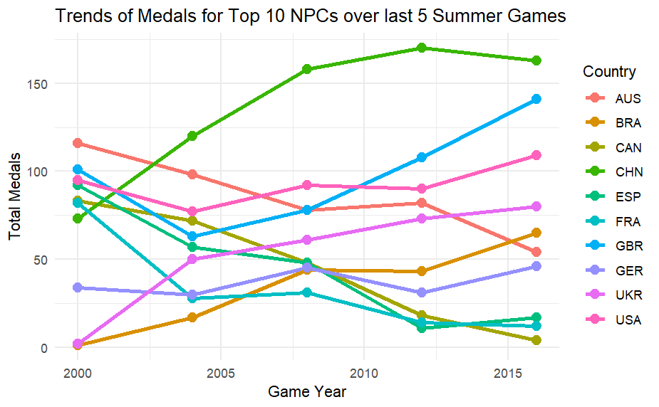
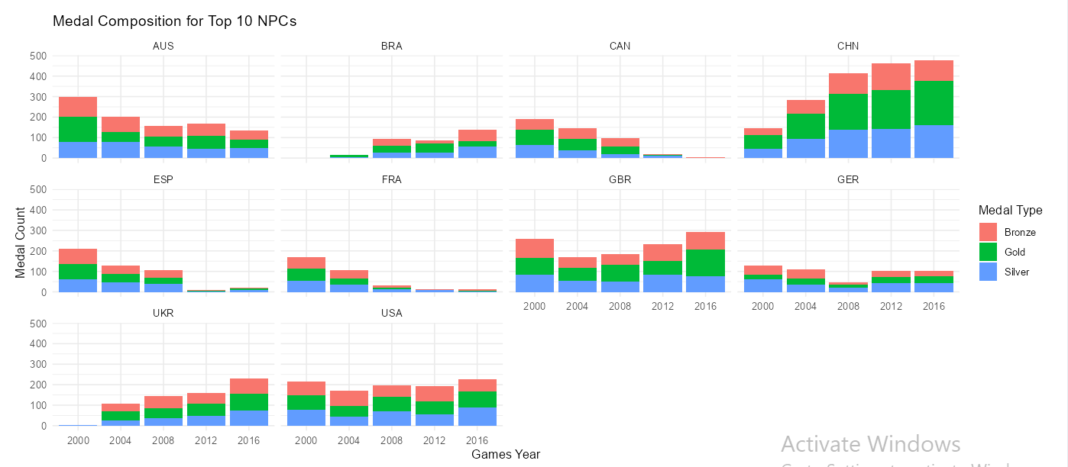
QUESTION 1: MEDAL TRENDS AND COMPOSITION
May 5, 2025
Data Decoders
Notes:
Line chart for total medals over last 5 Summer Paralympics
An evaluation based on medal count reveals the top ten Non-Permanent Members of the Committee.
CHN along with USA have demonstrated stable or increasing medal performance throughout the past five Summer Paralympics.
The competition results for various NPCs display irregular patterns.
Internal data about medal strategies together with financial investments become observable through specific insights.
Bar chart visuals display Gold Silver and Bronze medals separately per National Personnel Committee
The comparison of top 10 NPCs through five different games exists in the data set.
The visualization tool gives us knowledge about performance quality.
NPCs bearing more gold medals display higher dominance positions at the elite level.
The medal type distribution helps organizations understand their strength areas.

Slide 10
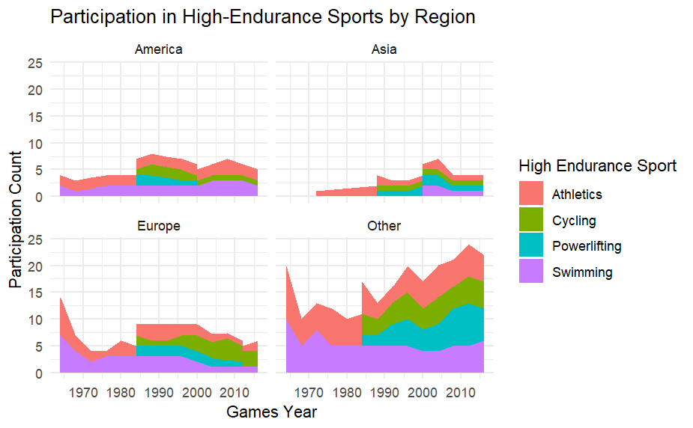
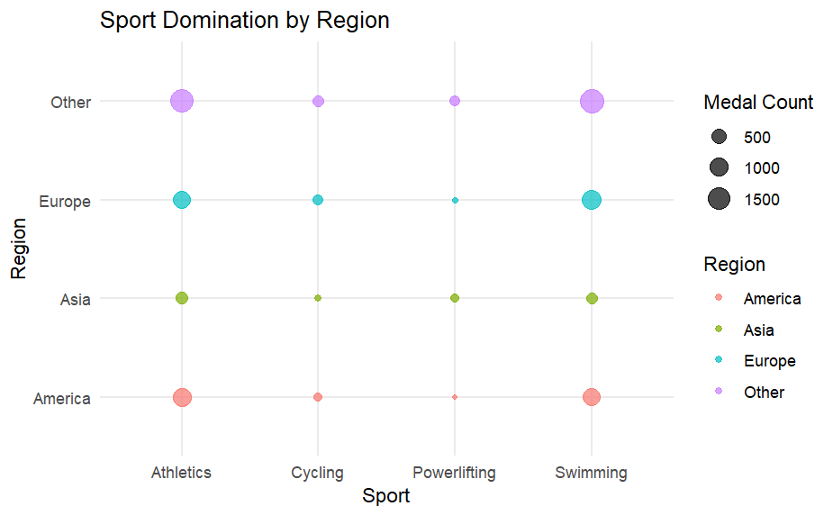
QUESTION 2: HIGH ENDURANCE SPORTS DOMINATION AND PARTICIPATION
May 5, 2025
Data Decoders
Notes:
The area plot illustrates regional group-based participation rate shifts from one time interval to another.
The sports participation sector organizes itself through Athletics paired with Swimming and Powerlifting which collaborate with Cycling as a subdiscipline set.
- Europe and Asia show high and rising involvement
A population advances its infrastructure while allocating financial resources through this phenomenon.
- Insight: Regional prioritization of endurance sports
Bubble plot of sports by region with medal count as size
Shows sport-specific regional dominance
E.g., Swimming in Asia, Athletics in North America
The size of bubbles demonstrates specific sports strength for each participating regional group.
The company exhibits clear strategic focus for particular regions through its business operations.

Slide 11

PARALYMPIC DASHBOARD INTERFACE
May 5, 2025
The application was constructed through R Shiny to ensure its responsive behavior.
The application allows users to select from four options: year, sport, country and season.
The system displays interactive charts that update their visualization data as users provide new input.
The application displays important metrics through summary boxes.
Clean layout with minimal theme.
Data Decoders

Slide 12

ADVANTAGES
May 5, 2025
The solution allows users to obtain valuable insights directly from raw datasets starting from their initial state.
No need for manual preprocessing.
Interactive features increase accessibility.
Supports both beginner and expert users.
Data Decoders

Slide 13

CHALLENGES
May 5, 2025
Debugging dashboard crashes.
Passing plots and data transformation codes dynamically.
Renaming filter labels.
Using complex plots.
Data Decoders

Slide 14

CONCLUSION
May 5, 2025
We built a tool not only to explore our dataset but also to empower others to answer and explore their data.
This could benefit INFO 526 students in future semesters especially during Project 1 when they are not exposed to R Shiny Dashboard
It also helps to work with messy data.
Data Decoders

Slide 15

THANK YOU!!!
May 5, 2025
QUESTIONS ARE WELCOME
AAAAAAND LET’S GO HAVE A LOOK AT OUR DASHBOARD :)
Data Decoders

